Slide 1
TASK 5:Data Analytics Internship Portfolio
Presented by:S.Vaishnavi

Slide 2
Internship Overview
• Task 1 – Data Immersion & Wrangling
• Task 2 – EDA & Business Intelligence
• Task 3 – Deep-Dive Analysis & Dashboarding
• Task 4 – Data Storytelling & Statistical Validation
• Task 5 – Portfolio Finalization

Slide 3
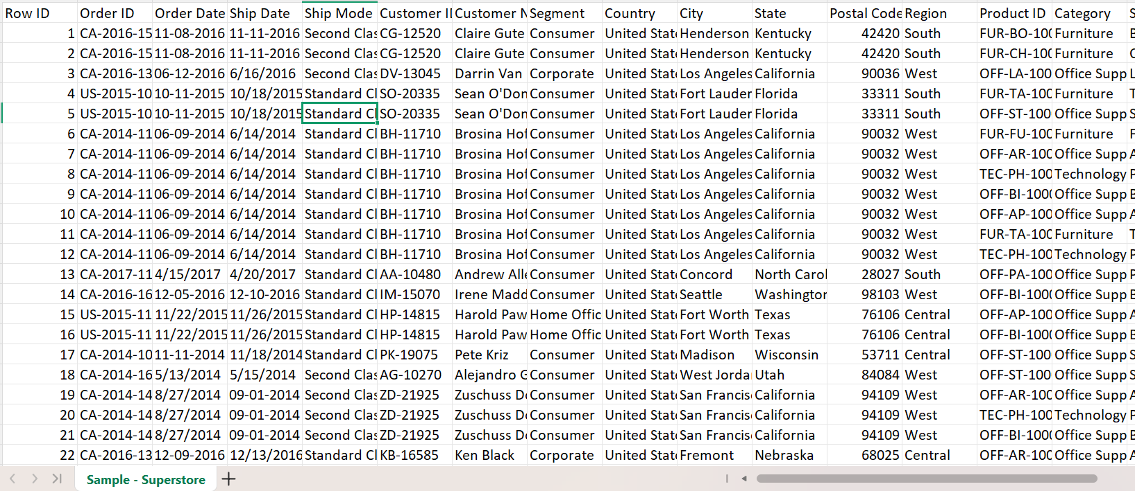
Dataset Overview
Dataset Used: Superstore Sales Dataset
Features: Order ID, Customer Name, Region, Category, Sales, Profit
Purpose: Analyze sales performance and generate business insights.

Slide 4
Task 1 – Data Cleaning & Wrangling
Objective: Prepare raw data for analysis.
Completed:
• Missing Value Detection
• Duplicate Removal
• Data Type Conversion
• Data Standardization
• Feature Engineering
Outcome: Cleaned dataset ready for analysis.

Slide 5
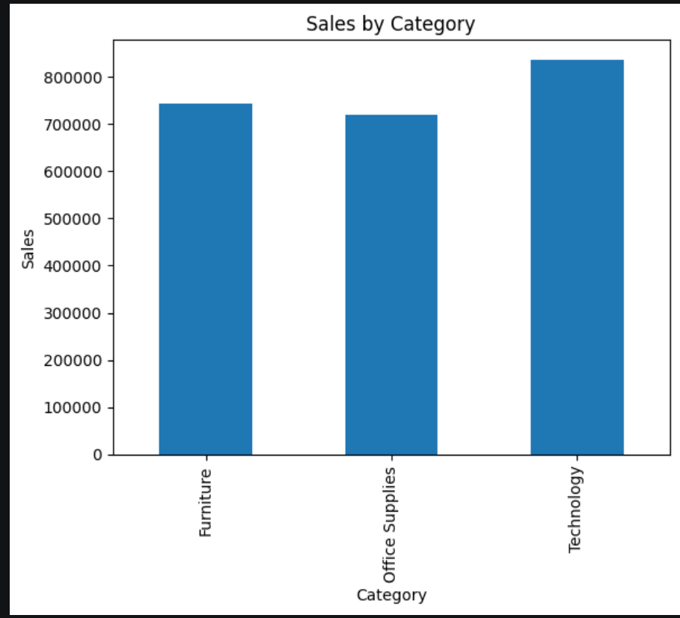
Task 1 :Results
Data Quality Improvements:
• Missing values handled
• Duplicates removed
• Invalid formats corrected
Tools Used: Python, Pandas, NumPy

Slide 6
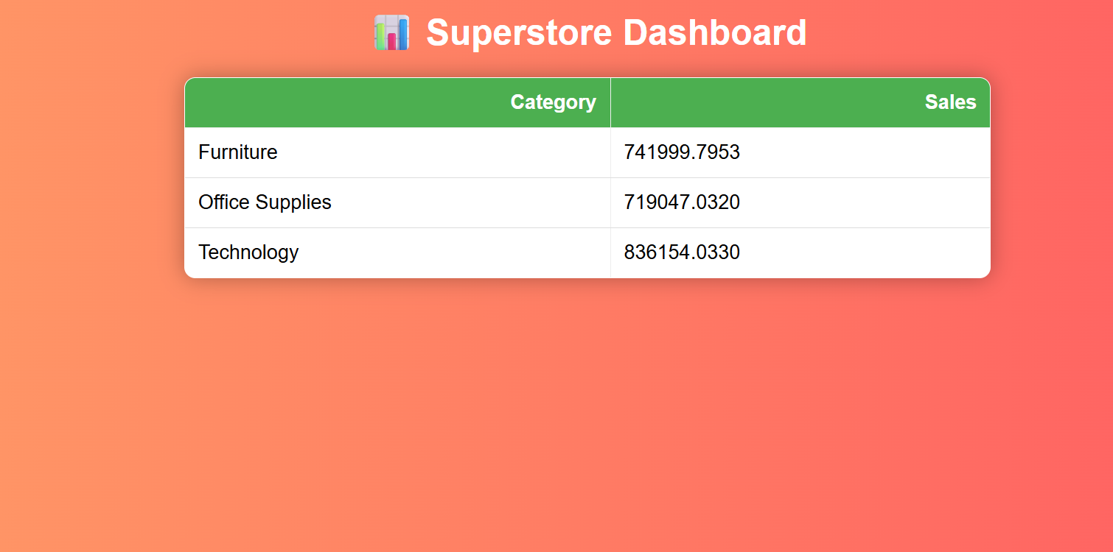
Task 2 – Exploratory Data Analysis
Objective: Discover trends and patterns.
Analysis Performed:
• Sales Distribution
• Profit Distribution
• Category Analysis
• Regional Performance

Slide 7
SQL QUERIES
Examples:
1. Top Performing Categories
2. Highest Revenue Products
3. Monthly Sales Trend
4. Most Profitable Region
SQL Skills: SELECT, GROUP BY, ORDER BY, JOIN, SUM(), AVG()

Slide 8
Key EDA Insights
• Technology generated highest sales
• Furniture showed lower profit margins
• West Region generated highest revenue
• Top customers contributed significant revenue

Slide 9
Task 3 – KPI Development
Core KPIs:
• Total Sales = Sum(Sales)
• Total Profit = Sum(Profit)
• Profit Margin = Profit/Sales × 100
• Average Order Value = Sales/Number of Orders

Slide 10
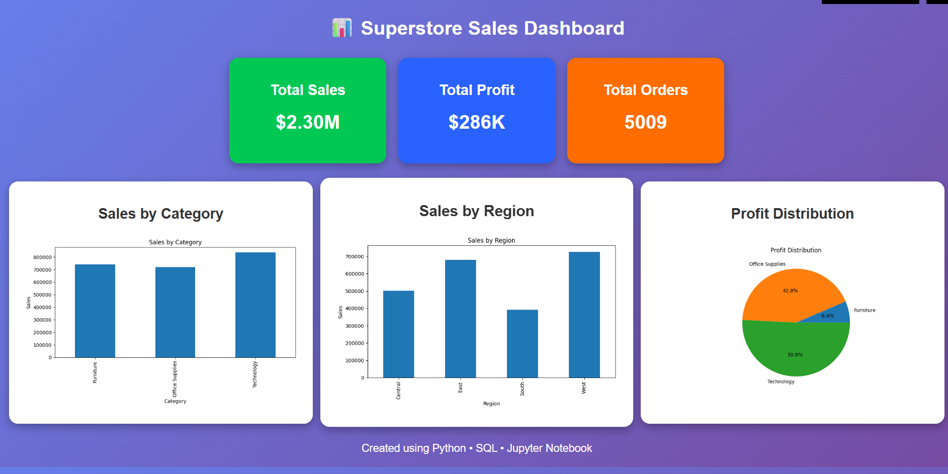
Interactive Dashboard
Dashboard Features:
• KPI Cards
• Category Filters
• Region Filters
• Sales Trend Analysis
• Profit Analysis

Slide 11
Task 4 – Data Storytelling
Business Problem:
How can sales growth be improved while maintaining profitability?
Story Structure:
1. Business Objective
2. Data Analysis
3. Insights
4. Recommendations

Slide 12
Statistical Validation
Hypothesis Testing:
H0: No significant difference exists.
H1: Significant difference exists.
Method: T-Test
Result: p-value < 0.05
Conclusion: Reject Null Hypothesis

Slide 13
Recommendations
• Focus on Technology Category
• Improve Furniture Profitability
• Target High-Performing Regions
• Retain Top Customers
• Monitor KPIs Regularly

Slide 14
Skills Gained
Technical Skills:
Python, Pandas, NumPy, SQL, Data Visualization, Statistical Analysis, GitHub
Business Skills:
Problem Solving, Data Storytelling, Decision Making

Slide 15
Conclusion
Internship Outcomes:
✓ Data Cleaning
✓ EDA
✓ SQL Analysis
✓ Dashboard Creation
✓ Statistical Testing
✓ Business Recommendations

Slide 16
THANK YOU

